Slide 1
Kubernetes Azure Kubernetes

Slide 2
Kubernetes
What is Kubernetes?
https://kubernetes.io/docs/concepts/overview/what-is-kubernetes/

Slide 3
Kubernetes
is a portable, extensible open-source platform
for managing containerized workloads and services,
that facilitates both
declarative configuration
and automation.
It has a large, rapidly growing ecosystem.
Kubernetes services, support, and tools are widely available.

Slide 4
Why do i need Kubernetes?
Kubernetes can be thought of as:
a container platform
a microservices platform
a portable cloud platform and a lot more
Kubernetes provides a container-centric management environment.
It orchestrates computing, networking, and storage infrastructure on behalf of user workloads.
simplicity of Platform as a Service (PaaS) with the flexibility of Infrastructure as a Service (IaaS)

Slide 5
What Kubernetes is not
Kubernetes is not a traditional, all-inclusive PaaS Since
Kubernetes operates at the container level rather than at the hardware level.
Kubernetes is not monolithic
default solutions are optional and pluggable.
Kubernetes provides the building blocks for building developer platforms, but preserves user choice and flexibility where it is important.

Slide 6
Kubernetes
Does not limit the types of applications supported
Does not deploy source code and does not build your application.
Does not provide application-level services, such as
middleware (e.g., message buses),
data-processing frameworks (for example, Spark),
databases (e.g., mysql), caches,
nor cluster storage systems (e.g., Ceph) as built-in services.
Such components can run on Kubernetes source code and and/or can be accessed by applications running on Kubernetes through portable mechanisms, such as the Open Service Broker.

Slide 7
Kubernetes
is not a mere orchestration system.
it eliminates the need for orchestration.
The technical definition of orchestration is execution of a defined workflow: first do A, then B, then C.
In contrast, Kubernetes is comprised of a set of independent, composable control processes that continuously drive the current state towards the provided desired state. It shouldn’t matter how you get from A to C. Centralized control is also not required.

Slide 8
Azure Kubernetes Service (AKS)
manages your hosted Kubernetes environment
helps to manage containerized applications without container orchestration expertise
eliminates the burden of ongoing operations and maintenance
by provisioning,
upgrading, and scaling resources on demand,
without taking your applications offline.

Slide 9
Introduction to Azure Kubernetes
Azure Kubernetes Service (AKS)
https://docs.microsoft.com/de-de/azure/aks/intro-kubernetes

Slide 10
Introduction to Azure Kubernetes
Quickstart: Deploy an Azure Kubernetes Service (AKS) cluster
Mit Azure Portal
https://docs.microsoft.com/de-de/azure/aks/kubernetes-walkthrough-portal
CommandLine Interface (CLI)
https://docs.microsoft.com/de-de/azure/aks/kubernetes-walkthrough

Slide 11
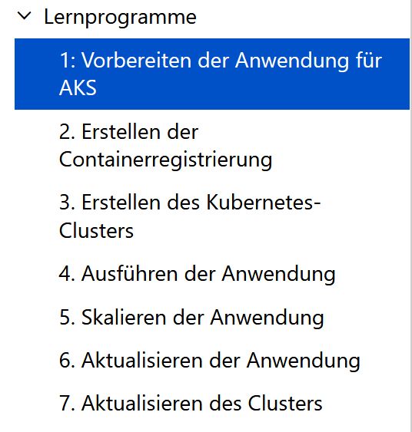
Step by Step Tutorial
Tutorial: Prepare an application for Azure Kubernetes Service (AKS)
https://docs.microsoft.com/de-de/azure/aks/tutorial-kubernetes-prepare-app

